Slide 1




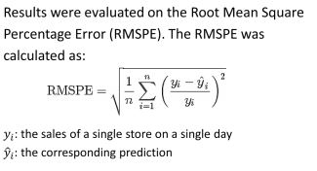

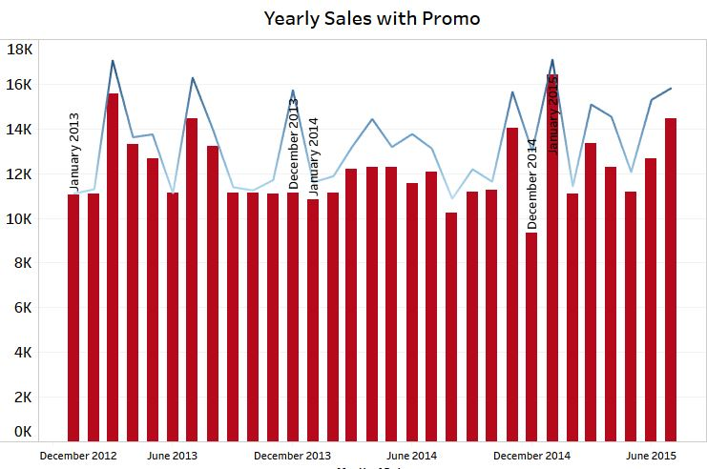
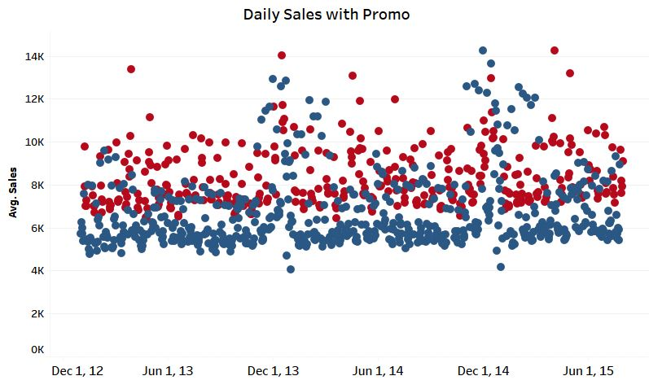
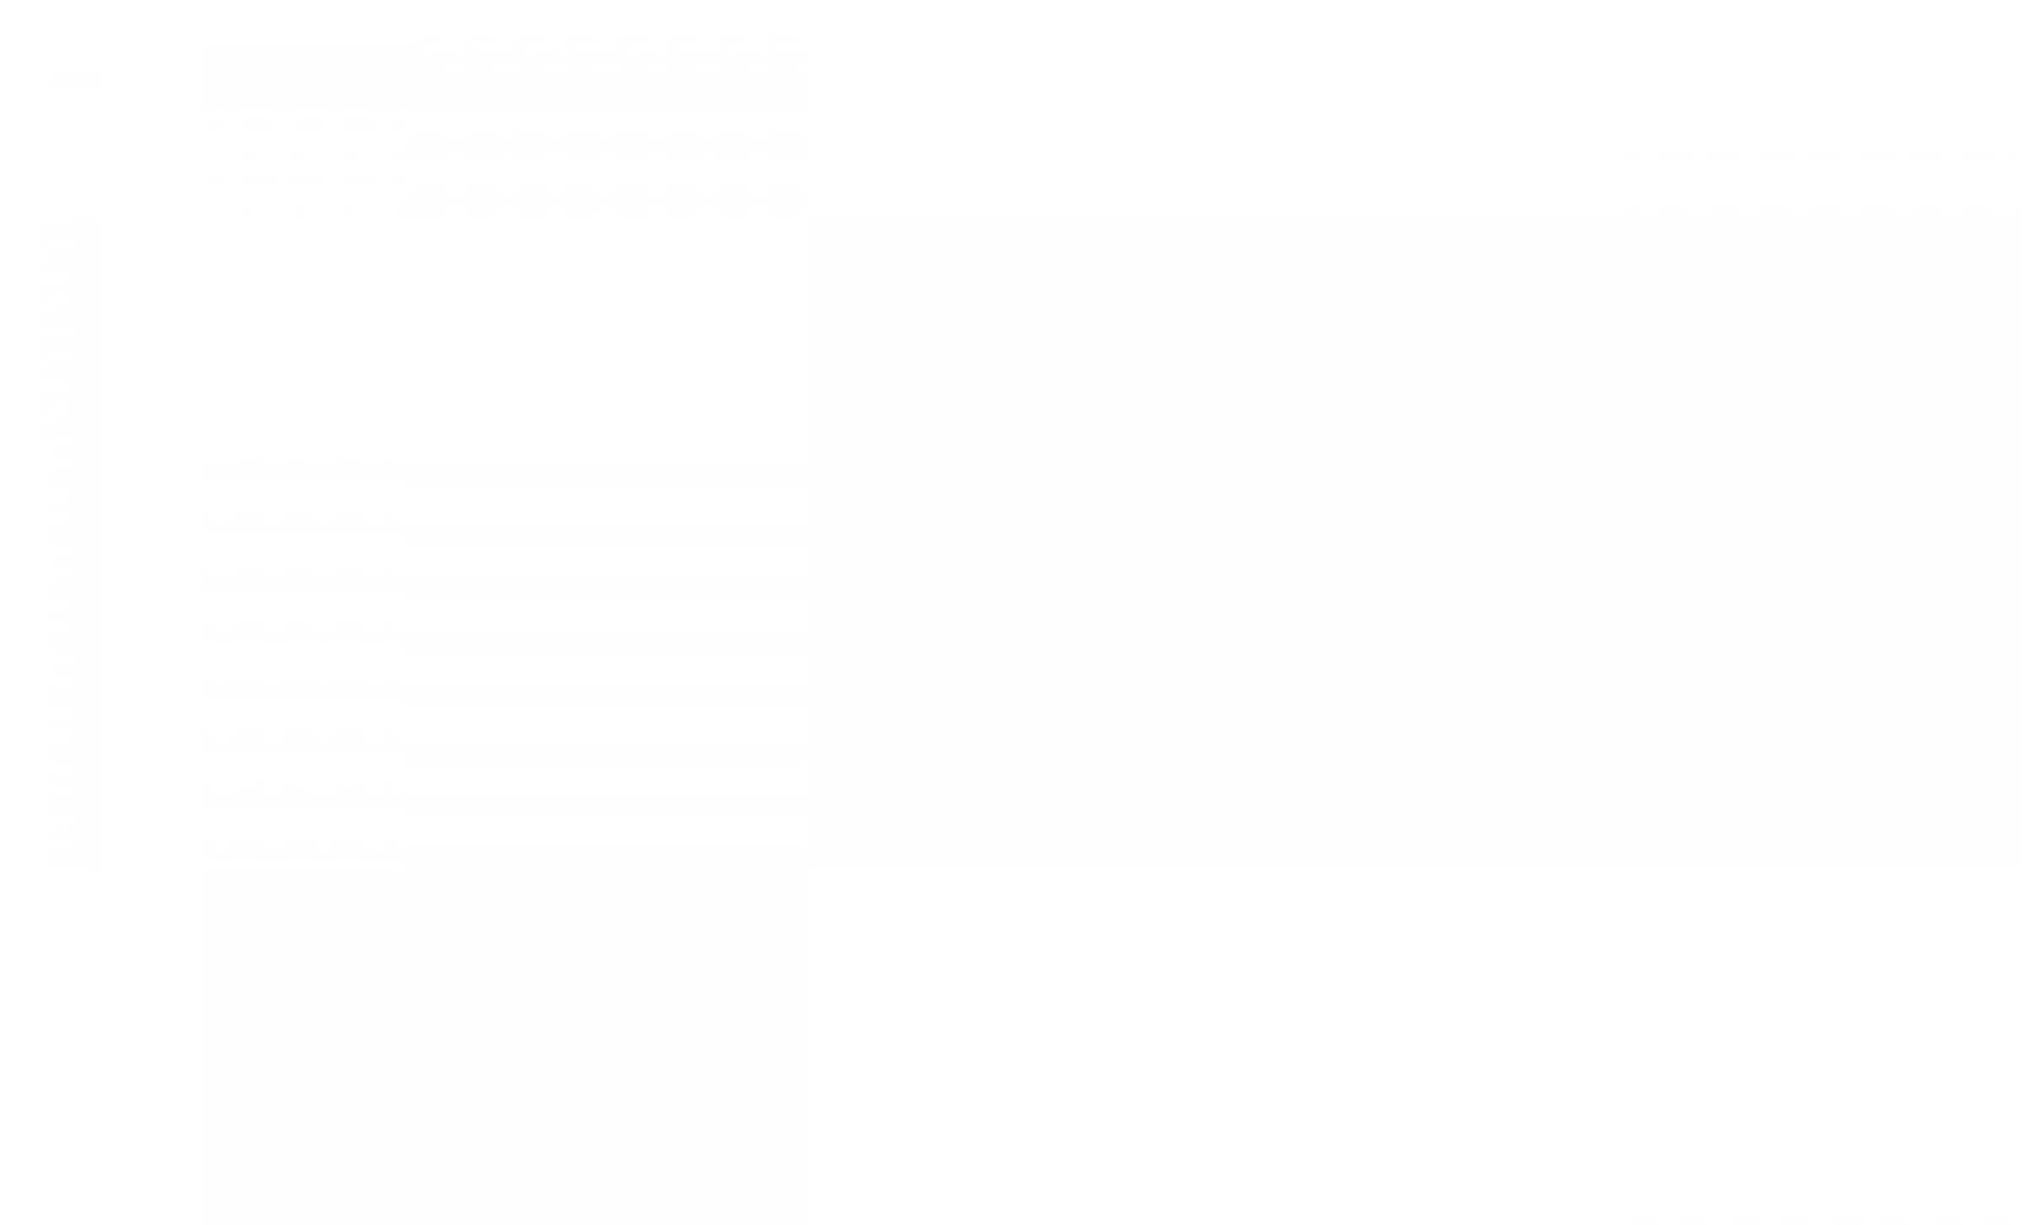
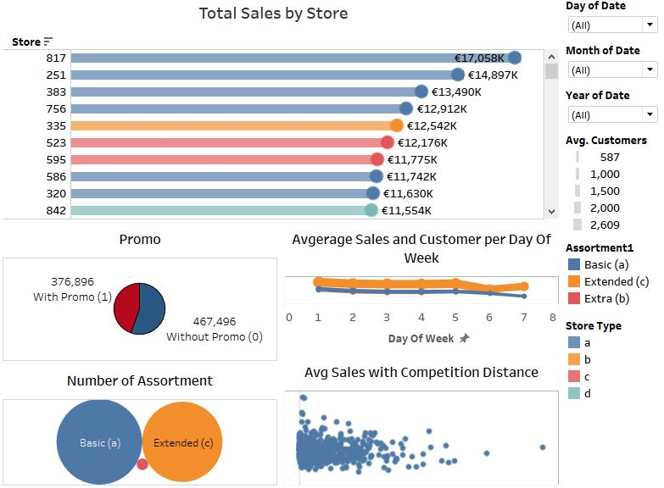

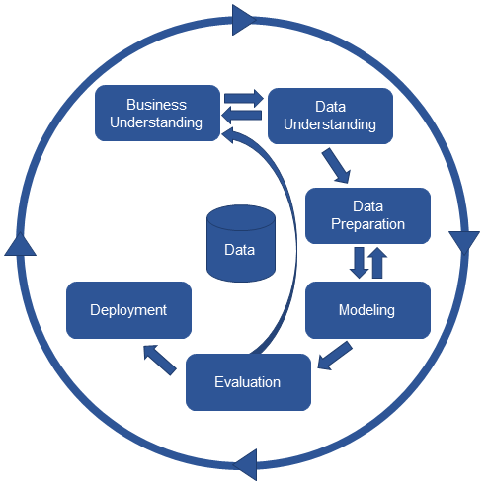
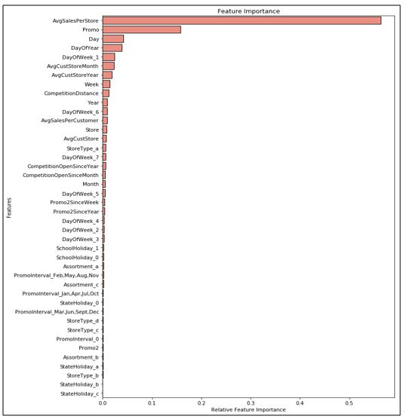
Predicting Sales For Rossmann Drug Stores
Shamee Mrimmoaee Ahmed
BSc (Hons) in Software Engineering – UC3F1805SE
Introduction
Model Evaluation
Rossmann operates over 3,000 drug stores in 7 European countries.
Stores sales are influenced by many factors, including promotions, competition, school and state holidays, seasonality, and locality. Reliable sales forecasts enable store managers to create effective staff schedules that increase product.
The aim of this project is to develop a decision support system which will predict sales in six weeks advance of Rossmann Drug Store. A visualization dashboard will be provided which will be showing all the relevant information about the sales of each store.
Exploratory Analysis
Single View Analysis
Data Source
Training and Testing Data Sets are provided by Rossmann on Kaggle.
The following variables / features were considered:
Open
Holiday: State Holiday, School Holiday
Promotion: Promo, Promo2, Promo Since [Year/Week], Promo Interval
Store: ID (Location), Type
Competitors: Comp. Open Since [Year/Week], Comp. Distance
Date: Day of Week, Month, Day, Year, Week
Additional Feature Created
AvgCustStore: - Average Customer in each store.
AvgCustStoreMonth: - Average Customer in each store per month.
AvgCustStoreYear: - Average Customer in each store per Year.
AvgSalesPerCustomer: - Average Sales in each store per Customer.
AvgSalesPerStore: - Average Sales in each store.
Providing a graphical view about how promotion increase monthly and yearly avg. sales.
Interactive Dashboard
This dashboard will show the individual store sales performance by providing different factor influencing about higher and lower sales
Technology
Model Performance
Python’s pandas and NumPy packages were used for cleaning data and exploratory analysis
Python’s Scikit-Learn package was used for developing prediction models
Python XGBoost package was used for developing Xtreme Gradient Boosting models
Tableau was used for data visualization
To better predict sales, the following models is developed
Model | RMSPE
Linear Regression | 0.2348
Random Forest Regressor (100 tress) | 0.1193
Xtreme Gradient Boosting (1000 trees) | 0.0999
Methodology
XG Boost demonstrated better performance compared to the other algorithms
Cross Industry standard process (CRISP) is chosen because it covers the business understanding that helps the developer to get a clear understanding about business perspective and uncover some essential factor that might influence the outcome of the project.
Best Feature Selection
Number of feature selected by the Random Forest Feature Selection is the best features

